Slide 1
Unit 1 Introduction to Java (Input-Processing-Output) Part 1 - Output
ICS3U/ICS3C

Slide 2
How does programming work?
•Computers on their own understand “machine language” – a string of 1’s and 0’s that basically act as on/off switches
•A programming language is a translator that converts instructions between human language and machine language
•A compiler is a program that takes the instructions written in the programming language and converts them into machine language for the computer to execute

Slide 3
1960’s-1970’s
•Major growth in the number of programming languages
•Pascal, C, Scheme, SQL, Prolog
•Many more recent languages were based on these
•Moved toward structured programming which provided clearer code, more guidelines on proper format, etc.

Slide 4
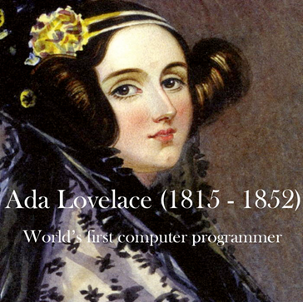
History of Programming
•First programmer was Ada Lovelace in the 1840s who created a language for the mechanical (non-electric) “Analytical Engine” created by Charles Babbage
•There is a language used primarily by government/military named ADA in her honour

Slide 5
1940’s and 1950’s
•First electric computers created in 1940s
•Programming was done in assembly languages which are very low-level, similar to machine code
•These do not require compiling but are very difficult to use and error-prone
•1950s higher-level languages that required compiling were introduced, including COBOL and FORTRAN (still used today)

Slide 6
Punch Cards
•They needed to code their programs on punch cards – physical cardboard papers that they would punch holes in different locations
•Cards were then run through a machine that transferred that information to the computer
•This made it VERY DIFFICULT to fix errors – you would need to repunch your whole card or even a stack of cards to fix a problem

Slide 7
Early Programming
•Punch cards were used until the 1980s
•Programs with older languages were much longer to write without modern languages
•Because computers were much more rare, early programmers and students would have to schedule time to test their programs – they did not each have exclusive use of a computer

Slide 8
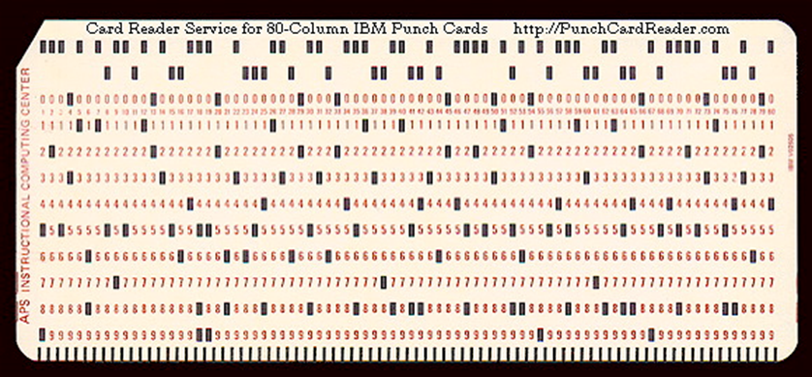
Punch Cards
•Once upon a time, programmers were not able to simply type their code into the computer and have the computer understand it.

Slide 9
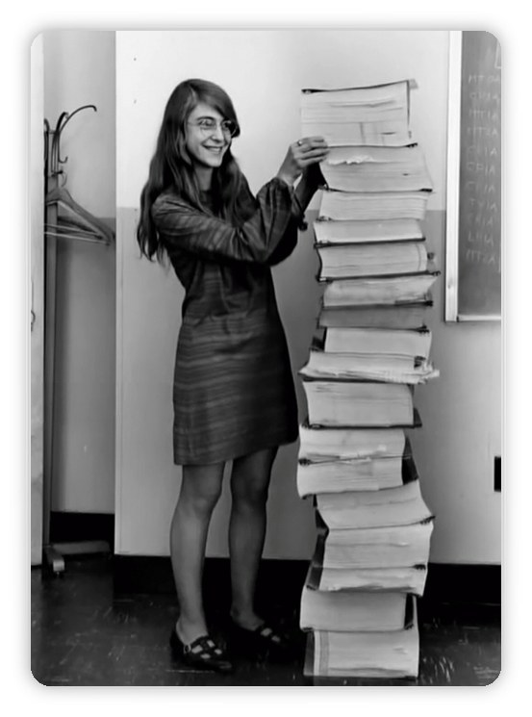
Stack of code!
Margaret Hamilton, lead software engineer on the Apollo Project next to the code she and her colleagues wrote for the guidance computer for the first moon landing (1969)

Slide 10
1980’s
•Exisiting languages began to be modified and adapted for specific uses
•Processor speeds improved allowing for better compilation techniques
•Changes in computer architecture to design computers for compilers rather than for human assembly programmers
Specialization

Slide 11
1990’s
•More user-friendly object oriented languages developed
•JavaScript became very popular because of ease of integration with web browsers
•New languages include Python, Visual Basic, Java, Delphi, Ruby and more
Internet Age

Slide 12
JAVA
Java Virtual Machine

Slide 13
JAVA
•We will be using Dr. Java. The .jar file to run it is in my folder on the AA: files and also available for free download online
•A few basic things to get you started with how to write code in Java and how to compile and run your programs
Getting Started

Slide 14
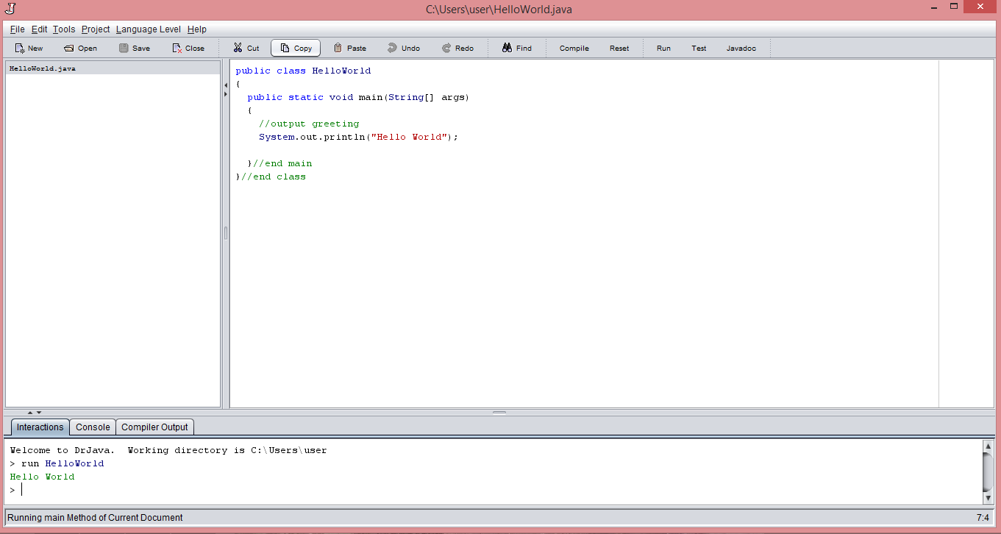
What your screen will look like
List of active programs
Where you write
your code
Output window

Slide 15
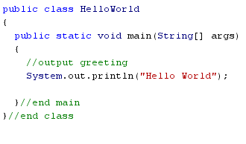
What your code looks like
Start your main
method
Name your program (“Class”)
Body of your program
End your main
method
Green are comments (start with “//”)
End your program

Slide 16
Text and Strings
The first command we learn is System.out.println( );
We use this to print out any text to the output window.

Slide 17
Printing Text
If you want to print out just some text, include it in the brackets in double quotes. System.out.println(“This text will print to the output window”);

Slide 18
Special Characters
Some special characters (or control codes) change how things are printed out.
For instance, if you want to actually have quotation marks printed out, it is hard for Java to understand whether the quotes should print or whether you are trying to end the text:
System.out.println(“I want to use “quotes” in my sentence”);
This would give an error - why??

Slide 19
Control Codes
To indicate that you have a special character, we put a backslash (\) immediately before that character. That tells the computer to treat the following character differently from normal.
System.out.println(“I want to include \”quotes \” in my sentence”);
Would print out the line: I want to include “quotes” in my sentence

Slide 20
Control Codes
There is a list of control codes in the note that you should know how to use (in a chart).
Practice using each of these in your code, see how they work and see how you can combine them in print statements before you move on to the assignment.

Slide 21
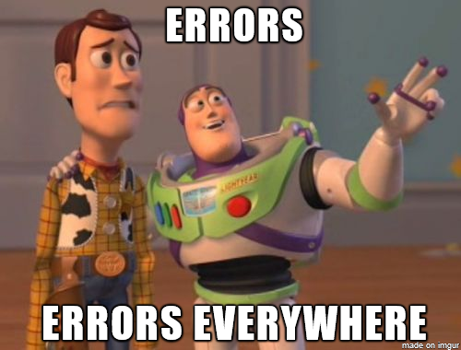
Errors (you’ll all get them!!)

Slide 22
Syntax Errors
The most common type of errors you’ll see at first
These errors are when your code is correct in theory but the commands are somehow written incorrectly so it will not compile

Slide 23
Common Syntax Errors
Common errors
- case sensitive (caps or lowercase incorrect)
- forgotten semi-colon
- spelling errors
- errors in bracket placement
- naming the java file differently than the class name

Slide 24
Help each other!!
The good news about syntax errors are that they’re easier to fix!
Look through your code for the 5 things above
Ask a friend to look through your code with you
Google the error message to figure out what it means
THEN ask me for help!
(I will have more time to help everyone if I don’t spend half of each class finding lost semicolons!)

Slide 25
Logic Errors
As you get more experienced and write more complex code, syntax errors become less common and logic errors become more common.
With logic errors your code will still compile and run, but it won’t do what you want it to
This means there is an error in your logical thinking, the order you’ve written commands or how you’re using the commands.

Slide 26
Commenting
It is important to comment your code. This helps you debug (find logic errors) in more complex programs and helps other coders figure out how your code works and use your code for similar applications
Also, 25% of your final mark is in COMMUNICATION and most of this comes from how understandable (well commented!) your code is

Slide 27
Types of Comments
Header comments/block comments – title, name, date, description of what your program does
Variable comments – explain what each variable is used for as you declare them (will come back to this later)
In-line comments – explain commands you’re using
Bracket comments – help you match up opening/closing brackets in pairs (i.e. class and main)

